Slide 1
Rethinking Presentations:
The Assertion-Evidence Approach
Your Name
Michael Alley
assertion-evidence.com
Notes:
This set of slides is designed to help you (the engineer or scientist) introduce the assertion-evidence approach to your work group. Your goal should not be to win everyone over on this seminar. Rather, your goal should be to persuade the audience to be engineers and scientists and to experiment with the approach in a presentation. This presentation consists of several slides to introduce what the assertion-evidence approach is, to show why engineers and scientists should consider using it, and to set you up to show an assertion-evidence presentation of yours that your colleagues will relate to.
This first slide is a title slide for your seminar. You are encouraged to add your name above the name of Michael Alley, who authored this set of slides. Also, please feel free to substitute one of your slides for the example that is shown. On this slide, you should mention the goal of this presentation: to show your group a new approach to presentations that many engineers and scientists at respected institutions (Penn State, MIT, Rose-Hulman, Cornell, University of Wisconsin, Simula Research Lab, University of Oslo, Texas Instruments, Asuragen) are finding effective. You might say something to the effect that you hope your group will be open to this approach as a possible means for continual improvement.
Reference:
Michael Alley, The Craft of Scientific Presentations, 2nd ed. (New York: Springer-Verlag, 2013), pp. 132-135.

Slide 2
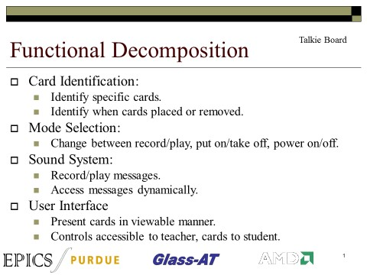
Engineers and scientists often name the same problems with slides
1. Too many words
2. Cluttered—not sure where to look
3. Much text not readable
Notes:
2
This slide presents results of a survey to hundreds of engineers and scientists around the world for the question: What three things would you change about the slide projected in a scientific or technical presentation? These three answers are the most common answers. Note that they are the same for native and non-native speakers of English.
Please let your audience know that among professionals (all over the world), about 9 out of 10 have “too many words” on their lists. Answers 2 and 3 appear on about half of the lists.
Note that there are no wrong answers to the survey question, but your audience should see what many engineers and scientists identify as the common problems. This list is a valuable takeaway from this presentation.
You might also note that the “too many words” complaint supports what psychology research has found—namely, that audiences have a difficult time processing many written words while listening to a speaker. Research has found that common presentations project about 35-40 words per minute, which is way too much according to psychology researcher John Sweller.
Reference:
Michael Alley, The Craft of Scientific Presentations, 2nd ed. (New York: Springer-Verlag, 2013), p. 111.

Slide 3
Build your talk on
messages
not on topics
Notes:
3
The slide begins an executive summary of the assertion-evidence approach. The first principle is to begin your talk on messages, rather than topics which is what most people do. The reason for this principle is that building your talk on messages (assertions) makes you much more focused than building your talk on topic phrases.
Reference:
Michael Alley, The Craft of Scientific Presentations, 2nd ed. (New York: Springer-Verlag, 2013), pp. 132-135.

Slide 4

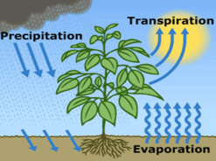
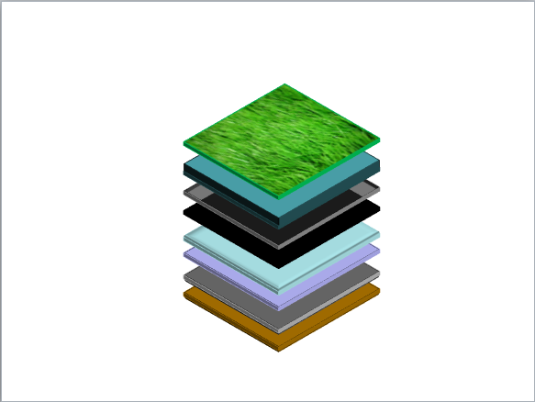
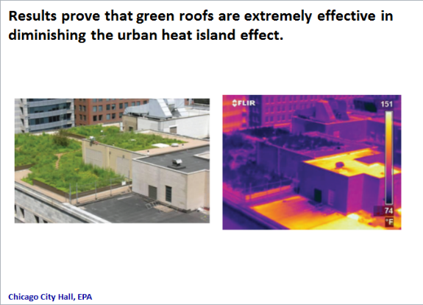
Support your messages
with visual evidence
not bullet lists
Notes:
4
The second guideline is that you should support your messages with visual evidence, not bullet points. That visual evidence could be photographs, [ANIMATE] drawings, [ANIMATE] diagrams, [ANIMATE] graphs, or other visual evidence such as equations or films. The reason for this principle is two-fold. First, the Australian psychology researcher John Sweller has found that audiences can process only so many written words when listening to an audience. If the audience tries to process too many words, the verbal part of the brain becomes overloaded and the audience actually comprehends less than if they had just listened and no written words were projected at all.
Second, Richard Mayer, a psychology researcher from UC Santa Barbara has found that audiences can process relevant visual evidence while listening to a speaker. Moreover, he has found that audiences learn more deeply from words and images than words alone.
Reference:
Michael Alley, The Craft of Scientific Presentations, 2nd ed. (New York: Springer-Verlag, 2013), pp. 130-139, 184.

Slide 5
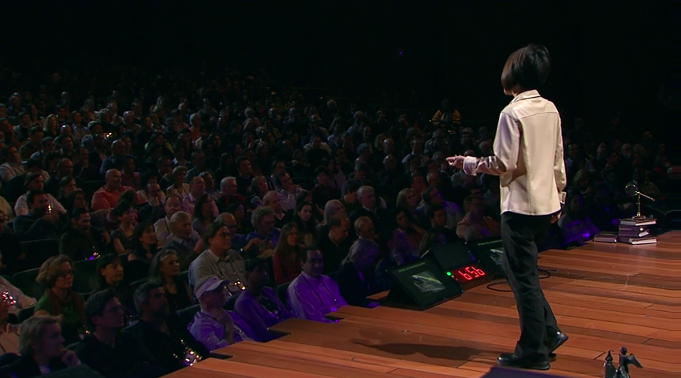
To present that evidence,
fashion sentences on the spot
Notes:
The third principle of the assertion-evidence approach is that you fashion your sentences on the spot, but after planning and practice. Delivering the talk in this way allows you to make much more eye contact than someone who is constantly turning back to read bulleted items on the screen. Delivering in this way shows the audience that you own the information and allows you to project more confidence.
Certainly, you should turn back to the screen to point out details on your visual evidence. However, such turning back is natural because the audience should be looking at the screen at that time as well.
Not natural is to turn back to read bullet points as often happens in the common type of presentation. Although the audience might try to read the bullets for the beginning of the talk, people often become tired of reading because of cognitive overload. Then the presentation devolves into the audience watching the speaker reading bullet points from the screen. Such a delivery does not project confidence to the audience.
Transition: So now that you know the three main principles of the assertion-evidence approach, many of you are thinking that this approach is more difficult than the common approach of following PowerPoint’s defaults and creating a presentation with phrase headlines supported by bullet lists. And you are correct. This approach is more difficult. So why use it?
Reference:
Michael Alley, The Craft of Scientific Presentations, 2nd ed. (New York: Springer, 2013), pp. 120-123.

Slide 6
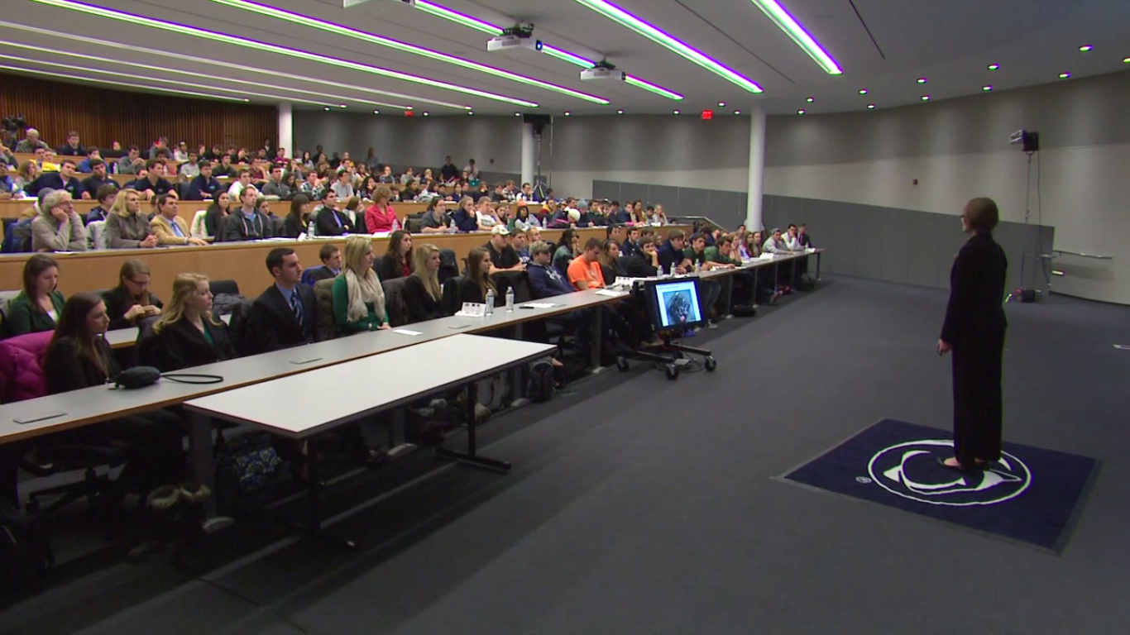
The success of a talk hinges on how much the audience understands, remembers, and believes
Notes:
One assumption for this talk is that the success of an engineering or scientific talk is how much the audience understands, remembers, and understands. With that assumption, let’s look at how the assertion-evidence approach fares.
Please note that although this talk does not discuss the third part of the assumption (“to believe”), assertion-evidence talks in general are more believable, according to the principles of Stephen Toulmin. According to Toulmin, audience are more likely to believe your argument if they know and appreciate the assertions. In an assertion-evidence talk, the assertions stand out. In a bullet-list talk, the assertions are usually buried in a bullet list.
References:
Image: Leonhard Center Speaking Contest, College of Engineering, Penn State: January 2014.
Michael Alley, The Craft of Scientific Presentations, 2nd ed. (New York: Springer, 2013), p. 91.

Slide 7
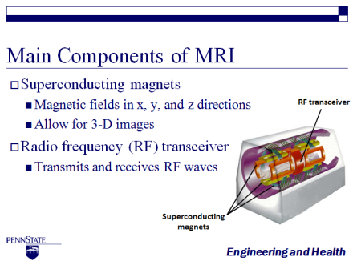
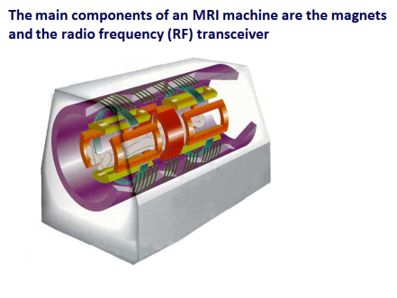

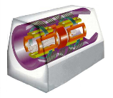
The question arises whether it is worth the extra work to create assertion-evidence slides
Common Practice
Assertion-Evidence
Notes:
7
This slide is part of a sequence that explains an experiment to test whether using the assertion-evidence approach leads to better audience understanding and recall. If you receive questions during this part, you can simply direct the audience to the website that explains the research: www.assertion-evidence.com/research-papers.html
Be sure to view this slide in the slideshow mode and be patient with the animation because it is on a delay.
References:
Joanna K. Garner and Michael Alley, “How the Design of Presentation Slides Affects Audience Comprehension: A Case for the Assertion–Evidence Approach,” International Journal of Engineering Education, vol. 29, no. 6 (2013), pp. 1564–1579
Michael Alley, The Craft of Scientific Presentations, 2nd ed. (New York: Springer, 2013), pp. 117-120.

Slide 8

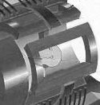
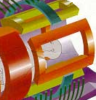
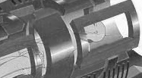

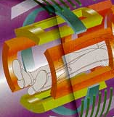
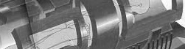
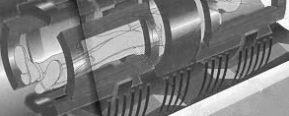
An MRI machine contains a large superconducting magnet, gradient magnets, and a radio frequency (RF) transceiver
RF transceiver
Gradient magnets
Gradient magnets
y
y
Superconducting
magnet
Superconducting
magnet
Superconducting
magnet
z
x
z
x
Notes:
This slide is part of a sequence that explains an experiment to test whether using the assertion-evidence approach leads to better audience understanding and recall. If you receive questions during this part, you can simply direct the audience to the website that explains the research: www.assertion-evidence.com/research-papers.html
References:
Joanna K. Garner and Michael Alley, “How the Design of Presentation Slides Affects Audience Comprehension: A Case for the Assertion–Evidence Approach,” International Journal of Engineering Education, vol. 29, no. 6 (2013), pp. 1564–1579
Michael Alley, The Craft of Scientific Presentations, 2nd ed. (New York: Springer, 2013), pp. 117-120.
8

Slide 9
In the tests, two groups of students viewed different PowerPoint talks with the same recorded script
Notes:
9
This slide is part of a sequence that explains an experiment to test whether using the assertion-evidence approach leads to better audience understanding and recall. If you receive questions during this part, you can simply direct the audience to the website that explains the research: www.assertion-evidence.com/research-papers.html
Be sure to emphasize that both rooms heard the exact same words.
References:
Joanna K. Garner and Michael Alley, “How the Design of Presentation Slides Affects Audience Comprehension: A Case for the Assertion–Evidence Approach,” International Journal of Engineering Education, vol. 29, no. 6 (2013), pp. 1564–1579
Michael Alley, The Craft of Scientific Presentations, 2nd ed. (New York: Springer, 2013), pp. 117-120.

Slide 10
How well did participants show that they understood the process?
Assertion-evidence slides led to better comprehension and recall of more complex concepts
42%
p < .01
59%
Notes:
10
This slide is part of a sequence that explains an experiment to test whether using the assertion-evidence approach leads to better audience understanding and recall. If you receive questions during this part, you can simply direct the audience to the website that explains the research: www.assertion-evidence.com/research-papers.html
Note that this slide begins with a question, but then animates in the assertion. The question is just a transition to allow the audience to comprehend the visual evidence, which for several might be unexpected. However, the scene concludes with the assertion. In a scientific or engineering presentation, the audience expects answers in the end.
References:
Joanna K. Garner and Michael Alley, “How the Design of Presentation Slides Affects Audience Comprehension: A Case for the Assertion–Evidence Approach,” International Journal of Engineering Education, vol. 29, no. 6 (2013), pp. 1564–1579
Michael Alley, The Craft of Scientific Presentations, 2nd ed. (New York: Springer, 2013), pp. 117-120.

Slide 11

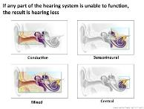
What we project on the screen should differ from what we give as a handout
Notes:
At this point, the most common objection to the assertion-evidence approach from people in industry is the claim that their slides also are to serve as a set of notes. These assertion-evidence slides might be fine for the presentation, but they will not work as a set of notes. Our counterargument is in two parts.
The first part [Animate] is that many people argue that is difficult, if not impossible, to have a set of slides that serves as a strong set of projected slides and a strong handout. Either the slides do not have enough words to serve as a handout or have too many words to be effective when projected.
The second part [Animate] is that PowerPoint actually has a wonderful, but underused, feature, the Notes Page, which allows the speaker to add information such as paragraphs and full reference citations to recreate what the speaker says during an assertion-evidence slide. What this feature allows is for a slide to be effective during the talk and when printed as a Notes Page for a handout.
Suggestion: Create a Notes Page for one of the slides that you will project in your presentation to present as an example.
References:
Michael Alley, The Craft of Scientific Presentations, 2nd ed. (New York: Springer, 2013), p. 107.
Reference for image: http://www.mattjhaught.com/presentations/

Slide 12
Notes:
12
This blank slide is a transition slide for you to preface an assertion-evidence talk that you created and that your audience can relate to. Our suggestion is that you present a talk of about 10-12 minutes. Mention that you will be glad to discuss your strategies for the different slides (title slide, mapping slide, body slides, and conclusion slide) at the end of the talk.
This talk is your chance to give your dream assertion-evidence talk at your company or laboratory—perhaps the talk that you wanted to give, but that some manager or colleague prevented you from giving.

Slide 13
Insert your slides here
Notes:
13
This blank slide is a transition slide for you to preface an assertion-evidence talk that you created and that your audience can relate to. Our suggestion is that you present a talk of about 10-12 minutes. Mention that you will be glad to discuss your strategies for the different slides (title slide, mapping slide, body slides, and conclusion slide) at the end of the talk.
This talk is your chance to give your dream assertion-evidence talk at your company or laboratory—perhaps the talk that you wanted to give, but that some manager or colleague prevented you from giving.

Slide 14
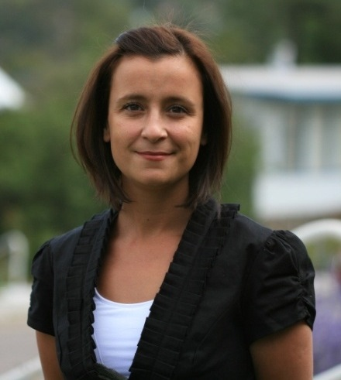
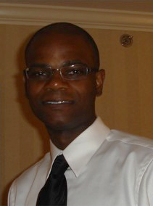

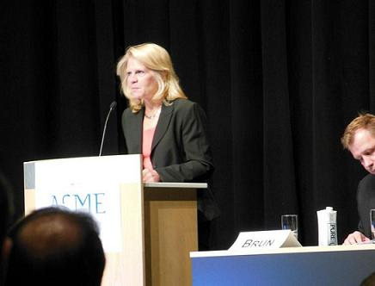
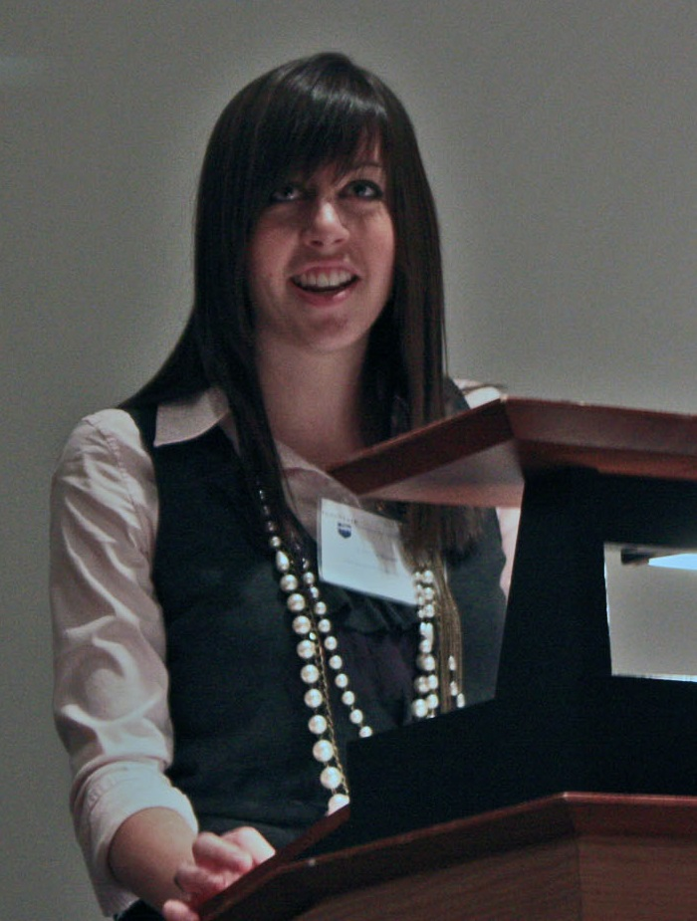
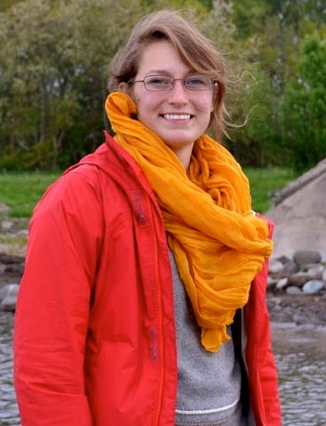
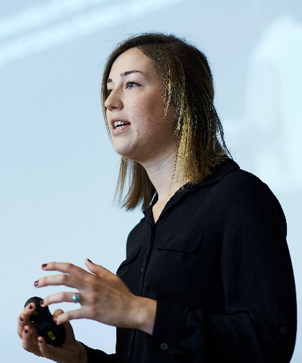

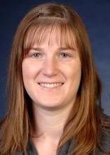
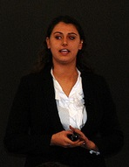
Many engineers and scientists have had success using the assertion-evidence approach
Notes:
14
Assertion-evidence presentations have been part of presentations that have won presentation awards, proposal contracts, and jobs. For instance, Kathryn Kirsch, an undergraduate in Mechanical Engineering at Penn State, won the best presentation award in the master’s category at the 2009 ASME Pressure Vessels and Piping Conference. She won that award after her sophomore year. In addition, as a junior, she was first runner-up in the same category at the 2010 conference.
Terry Johnson, a Ph.D. student in Aerospace Engineering, won first place in the graduate competition for best presentation at the 2010 SPIE Smart Structures and Materials Conference. Johnson was competing with 51 other graduate students.
The Engineering Ambassadors have received much acclaim for their presentations. The Network won $600,000 proposal, and much of the interest for that proposal occurred because NSF program managers saw outreach presentations made by the Ambassadors.
Six times in the past twenty years, Karen Thole’s research group has won the William Rosenhow award for best presentation by a young researcher in the Heat Transfer division of ASME. Interestingly, Thole’s graduate students have made presentations in this division in only six of the past twenty years. In other words, every times they have competed, they have won. In addition, every time they have competed, they have used the assertion-evidence approach. None of the other research groups at this conference have yet adopted the approach.
More Testimonials: http://www.assertion-evidence.com/testimonials.html

Slide 15
Not only are assertion-evidence talks more focused and better understood, but speakers project more confidence
Notes:
15
Reference:
Michael Alley, The Craft of Scientific Presentations, 2nd ed. (New York: Springer, 2013), pp. 117-123.

Slide 16
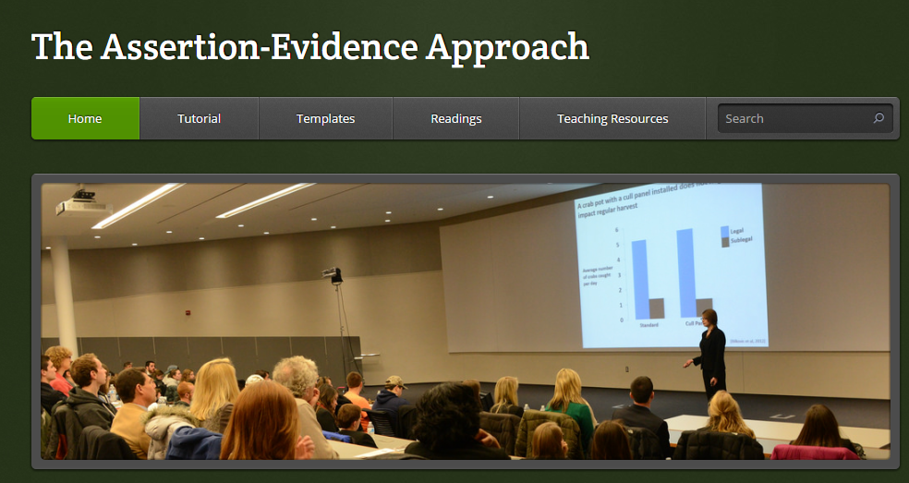
In conclusion, you should experiment with the assertion-evidence approach
www.assertion-evidence.com
Questions?
Notes:
16
Conclude by encouraging your colleagues to be an experimentalist and to try the assertion-evidence approach in a future presentation. You should mention to them that trying to create an assertion-evidence talk by beginning with PowerPoint’s defaults is difficult. A much better approach is to begin with one of the artist templates at www.assertion-evidence.com
Also at that website, your colleagues can find a short tutorial and supporting research.

Slide 17
Alternative Slides
Notes:
17
This blank slide marks the beginning of alternative slides for you to add or substitute for the slides toward the beginning of the presentation. For instance, one alternative would be to insert the next four slides, where slide 2 is and to delete the current slides

Slide 18
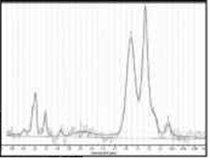
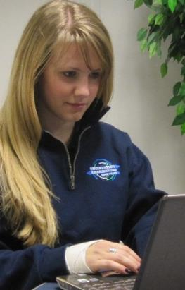
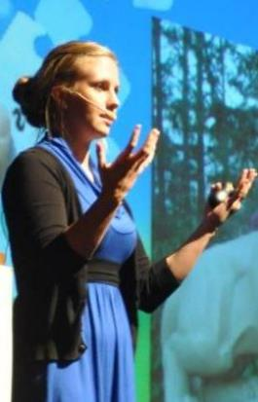
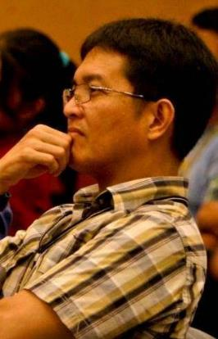
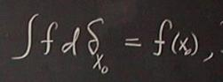
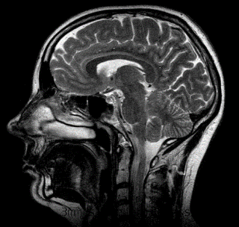
Most people do not realize how much slides affect the success, or failure, of scientific presentations
Notes:
18
Reference pages in The Craft of Scientific Presentations, 2nd ed.: pp. 117-122. Many people assume that the design of slides does not play an important role in a talk. However, the design of slides can significantly improve or weaken the success of a technical presentation. Slides influence a presentation in three distinct ways. The first occurs during the preparation of the talk. This stage is where the presenter defines the scope and depth. In this stage, the presenter decides what to include and, equally important, what to leave out. The way that many presenters create slides does not provide a good filter for what details to exclude.
Slides also influence a presenter’s delivery of their talk. Many slide designs contain a bulleted list. With such a list, many presenters (especially younger ones) adopt a death-by-PowerPoint style in which they turn to the slide to read a bullet point and then turn back to the audience. Such a style soon becomes tiresome for audiences.
Yet a third effect of slide design comes in the comprehension of the audience. Our research at Penn State has found that slides following an assertion-evidence approach, as opposed to the common practice (phrase headline supported by bullet list or by bullet list and image) leads to statistically significant improvements (p<.001) in the comprehension by audiences of technical information

Slide 19
PowerPoint’s defaults arose before research on slides and have not changed significantly
2003
1987
2007
[Gomes 2007]
Notes:
19
Reference:
Michael Alley, The Craft of Scientific Presentations, 2nd ed. (New York: Springer, 2013), p. 108.

Slide 20
PowerPoint’s defaults run counter to how people learn
Does not filter noise
Leads to too many written words
Consumes valuable space that should be used for images
[Garner et al., 2009]
Notes:
20
In addition to being antiquated, PowerPoint’s master slide default is not based on research. As mentioned, there is no research basis for having a bulleted list on a slide in terms of that list helping the audience understand the information (and in particular make connections among the details). Moreover that default leads to many words, which the psychologist John Sweller can often lead of overloading of the verbal channel of the brain. While the image function is a good step, it is not emphasized nearly enough.
Moreover, what are the chance that the speaker will choose a strong photo, drawing, diagram, or graph when the speaker begins the slide with a topic phrase headline, as the headline defaults leads people to do 85% of the time. Interestingly, even though you might think that a phrase would lead to fewer words on a slide and therefore less chance for cognitive overload which Sweller warns us about, our research has found that a sentence headline actually serves as a better filter against noise and leads not only to fewer words per slide, but almost half the number of words projected per minute.
Reference:
Michael Alley, The Craft of Scientific Presentations, 2nd ed. (New York: Springer, 2013), pp. 108-113.

Slide 21
PowerPoint’s defaults run counter to how people learn
We can do better
Notes:
21
The fact of the matter is that we can do better.

Slide 22
Back-Up Slides
Notes:
22
This blank slide marks the beginning of back-up slides for you to use during the question period.

Slide 23
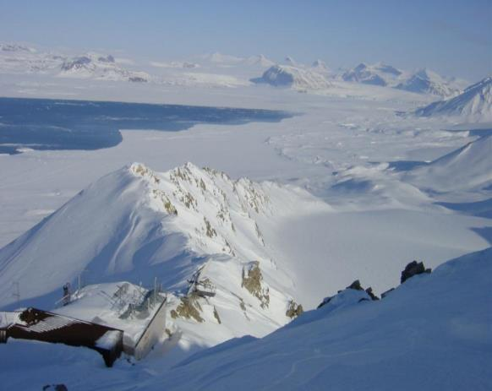



Determining Whether Atmospheric Mercury Goes Into Surface Snow After a Depletion Event
Katrine Aspmo
Torunn Berg
Norwegian Institute for Air Research
Grethe Wibetoe
University of Oslo
June 16, 2004
Mercury Level
Time
Notes:
23
References:
Michael Alley, The Craft of Scientific Presentations, 2nd ed. (New York: Springer-Verlag, 2013), pp. 140-142.
Aspmo, Katrine, Torunn Berg, and Grete Wibetoe, "Atmospheric Mercury Depletion Events (AMDEs) in Polar Regions During Arctic Spring," presentation (Oslo, Norway: University of Oslo, 16 June 2004).

Slide 24
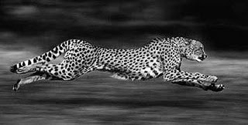
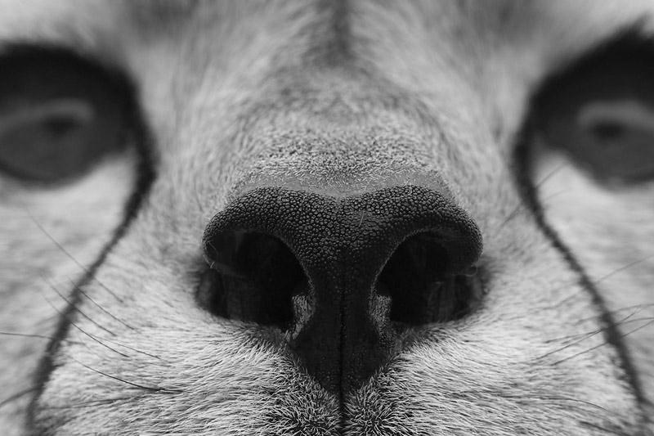
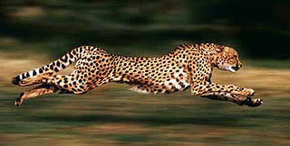

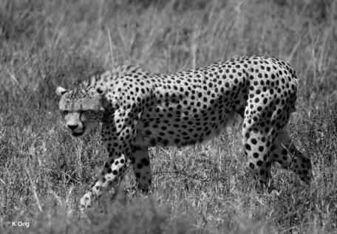
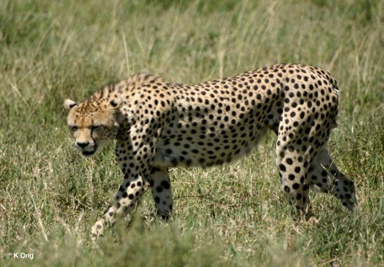

A cheetah is a great hunter because of its speed, keen senses, and clever strategies
Speed
Senses
[wildencounters.net]
[kreatifdinz.blogspot.com]
[wildencounters.net]
[kreatifdinz.blogspot.com]
Strategies
[luxurytravelblog.net]
[luxurytravelblog.net]
Notes:
Reference:
Michael Alley, The Craft of Scientific Presentations, 2nd ed. (New York: Springer-Verlag, 2013), pp. 83-85.

Slide 25
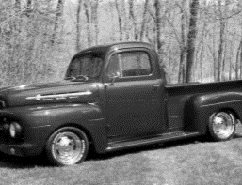
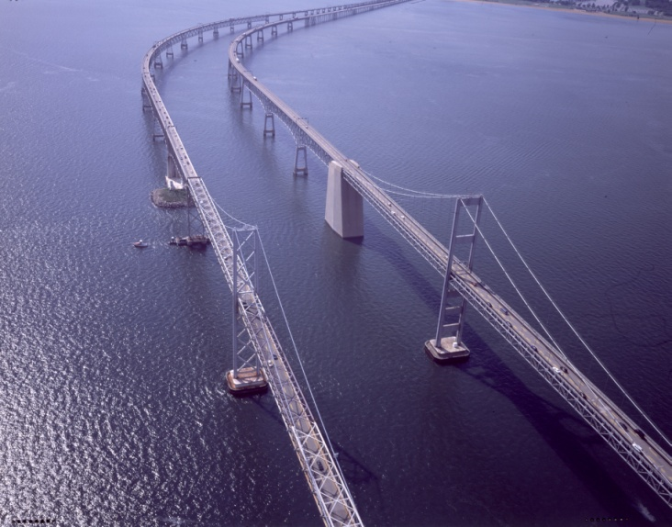
Since its construction in 1952, traffic across the bridge has grown exponentially
1952
1.1 million vehicles
[Maryland Transportation Authority, 2007]
Notes:
Brittany Pavelko, sophomore in Civil Engineering, Penn State: In 1952 when the bridge was constructed, there was 1.1 million vehicles traveling across the bridge annually.
Reference:
Michael Alley, The Craft of Scientific Presentations, 2nd ed. (New York: Springer-Verlag, 2013), pp. 140-142.
25

Slide 26
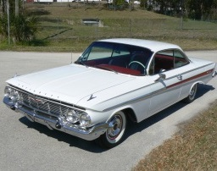
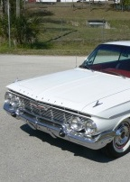
Since its construction in 1952, traffic across the bridge has grown exponentially
1952
1.1 million
1961
1.5 million
[Maryland Transportation Authority, 2007]
Notes:
Brittany Pavelko, sophomore in Civil Engineering, Penn State: In 1961, 9 years later, there were 1.5 million cars traveling across the bridge per year according to the Maryland Transportation Authority. This isn’t a large increase. However, lets jump to 2007. In 2007 there were
Reference:
Michael Alley, The Craft of Scientific Presentations, 2nd ed. (New York: Springer-Verlag, 2013), pp. 140-142.
26

Slide 27
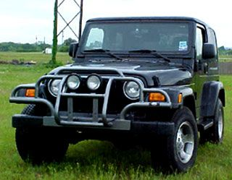

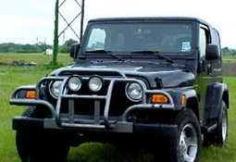
Since its construction in 1952, traffic across the bridge has grown exponentially
1952
1.1 million
1961
1.5 million
2007
27 Million
[Maryland Transportation Authority, 2007]
Notes:
Brittany Pavelko, sophomore in Civil Engineering, Penn State: …. 27 million cars crossing the Chesapeake Bay Bridge.
Reference:
Michael Alley, The Craft of Scientific Presentations, 2nd ed. (New York: Springer-Verlag, 2013), pp. 140-142.
27

Slide 28
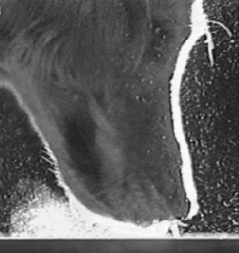
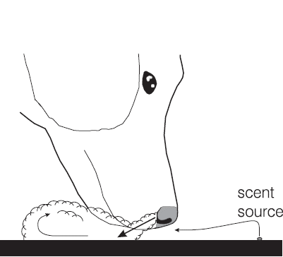
The way a dog sniffs does not contaminate the vapor stream from the scent source
scent
source
[Settles et al., 2002]
Notes:
References:
Michael Alley, The Craft of Scientific Presentations, 2nd ed. (New York: Springer-Verlag, 2013), pp. 130, 144.
Settles, Gary S., Kester, D.A., & Dodson-Dreibelbis, Lori. J. (2002). The External Aerodynamics of Canine Olfaction. Sensors and Sensing in Biology and Engineering. Ed. by F.G. Barth, J. A. C. Humphry, & T. W. Secomb. New York: Springer.

Slide 29

In summary, high concentrations of acetic acid help protect steel from corrosion
Adsorbed HOAc allows the growth of siderite
A thick siderite layer protects the steel from corrosion
FeCO₃
Steel
Fe_{3+x} O_{4-y}
Questions?
Notes:
29
Slide originated in a master’s defense by Omar Rosas Camacho, Material Science and Engineering, Penn State.
Reference:
Michael Alley, The Craft of Scientific Presentations, 2nd ed. (New York: Springer-Verlag, 2013), pp. 181-184.

